Slide 1
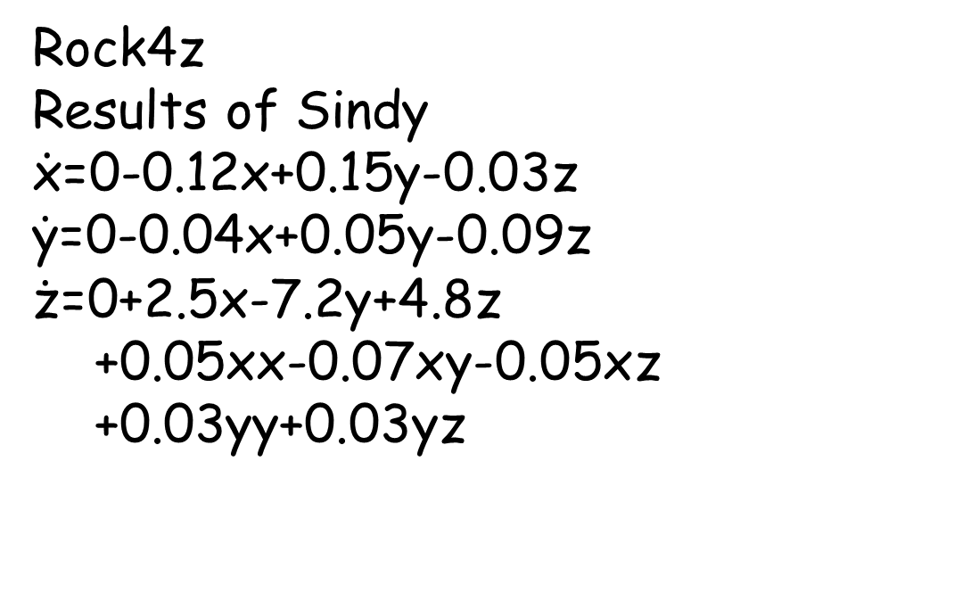
Rock4z
Results of Sindy
$\dot{\text{x}}$=0-0.12x+0.15y-0.03z
$\dot{\text{y}}$=0-0.04x+0.05y-0.09z
$\dot{\text{z}}$=0+2.5x-7.2y+4.8z
+0.05xx-0.07xy-0.05xz
+0.03yy+0.03yz

Slide 2
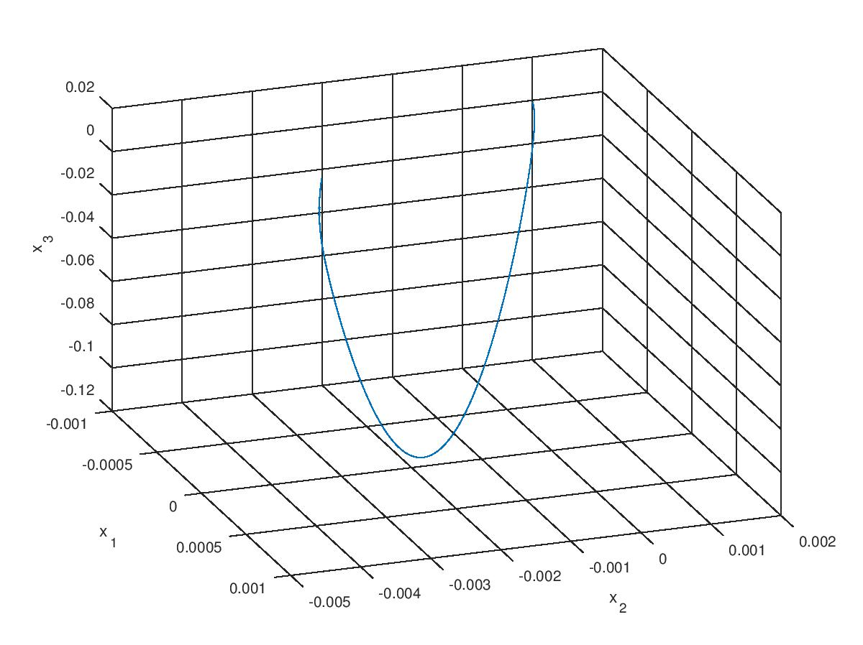

Slide 3
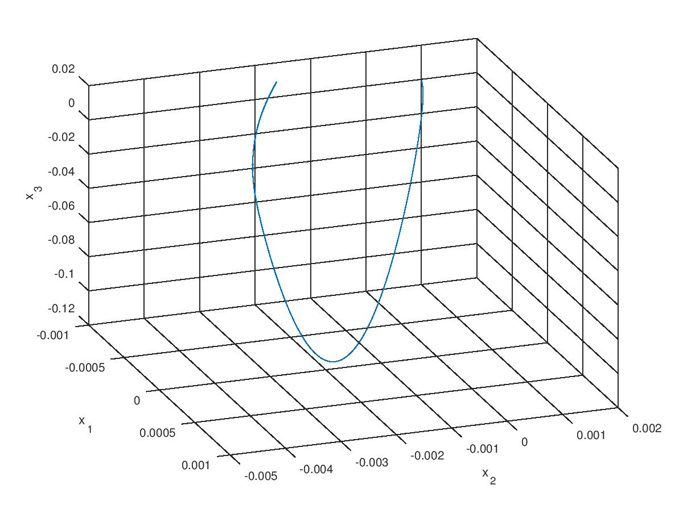

Slide 4
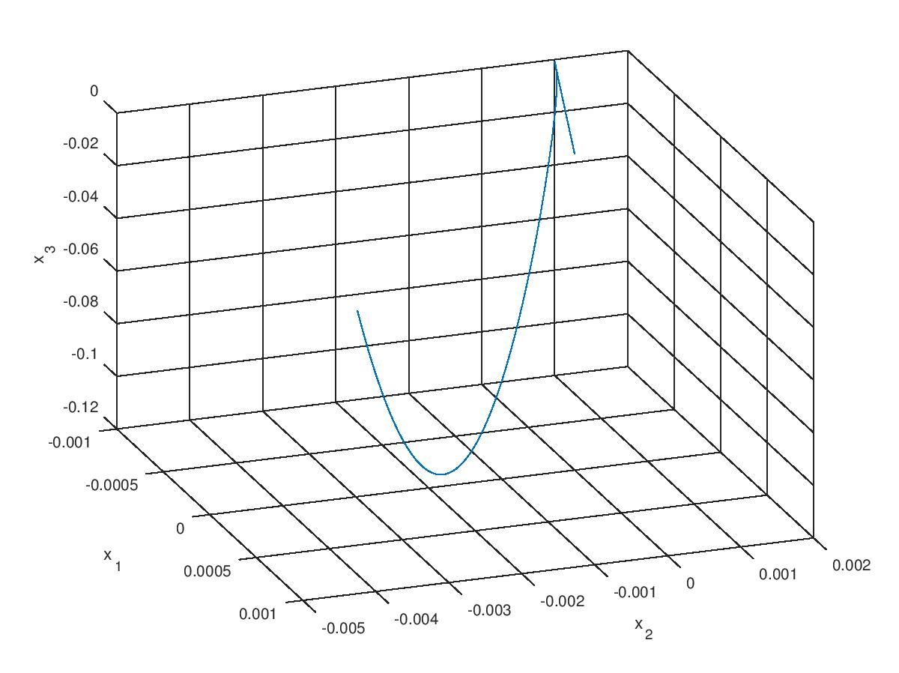

Slide 5
